Slide 1
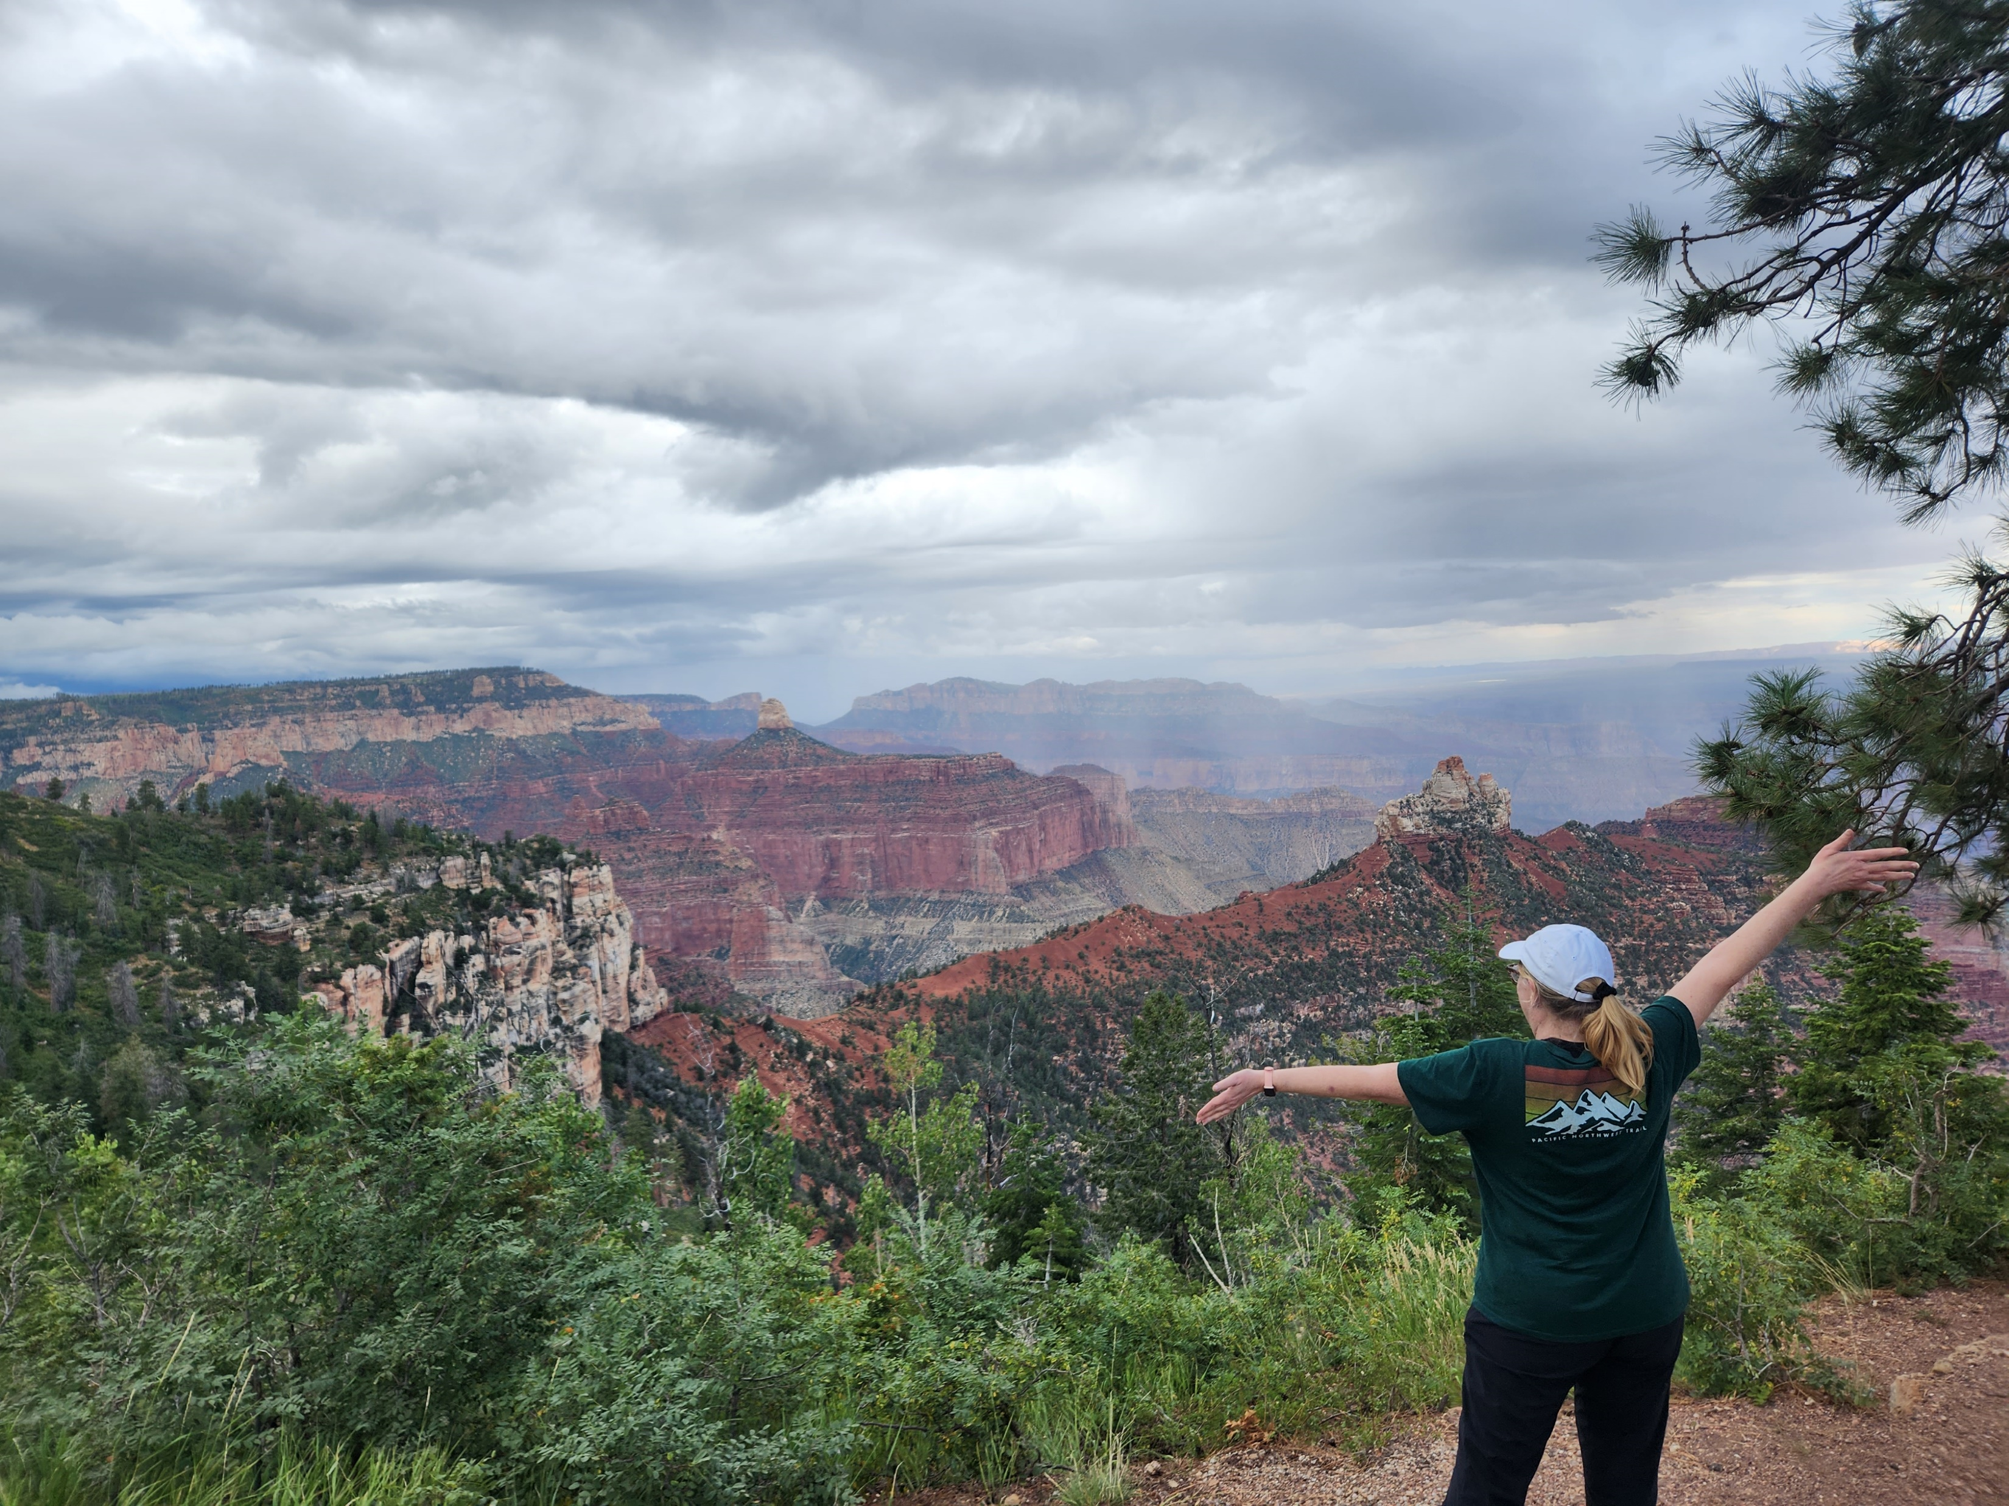
Sign Those Sprocs!: Avoiding Elevated Permissions with Module Signing
Sharon Reid
sharon.reid.harris@gmail.com
https://github.com/InfoJunkie1/TempPerms
St. Louis SQL Server and Power BI User Group
9 April 2024

Slide 2
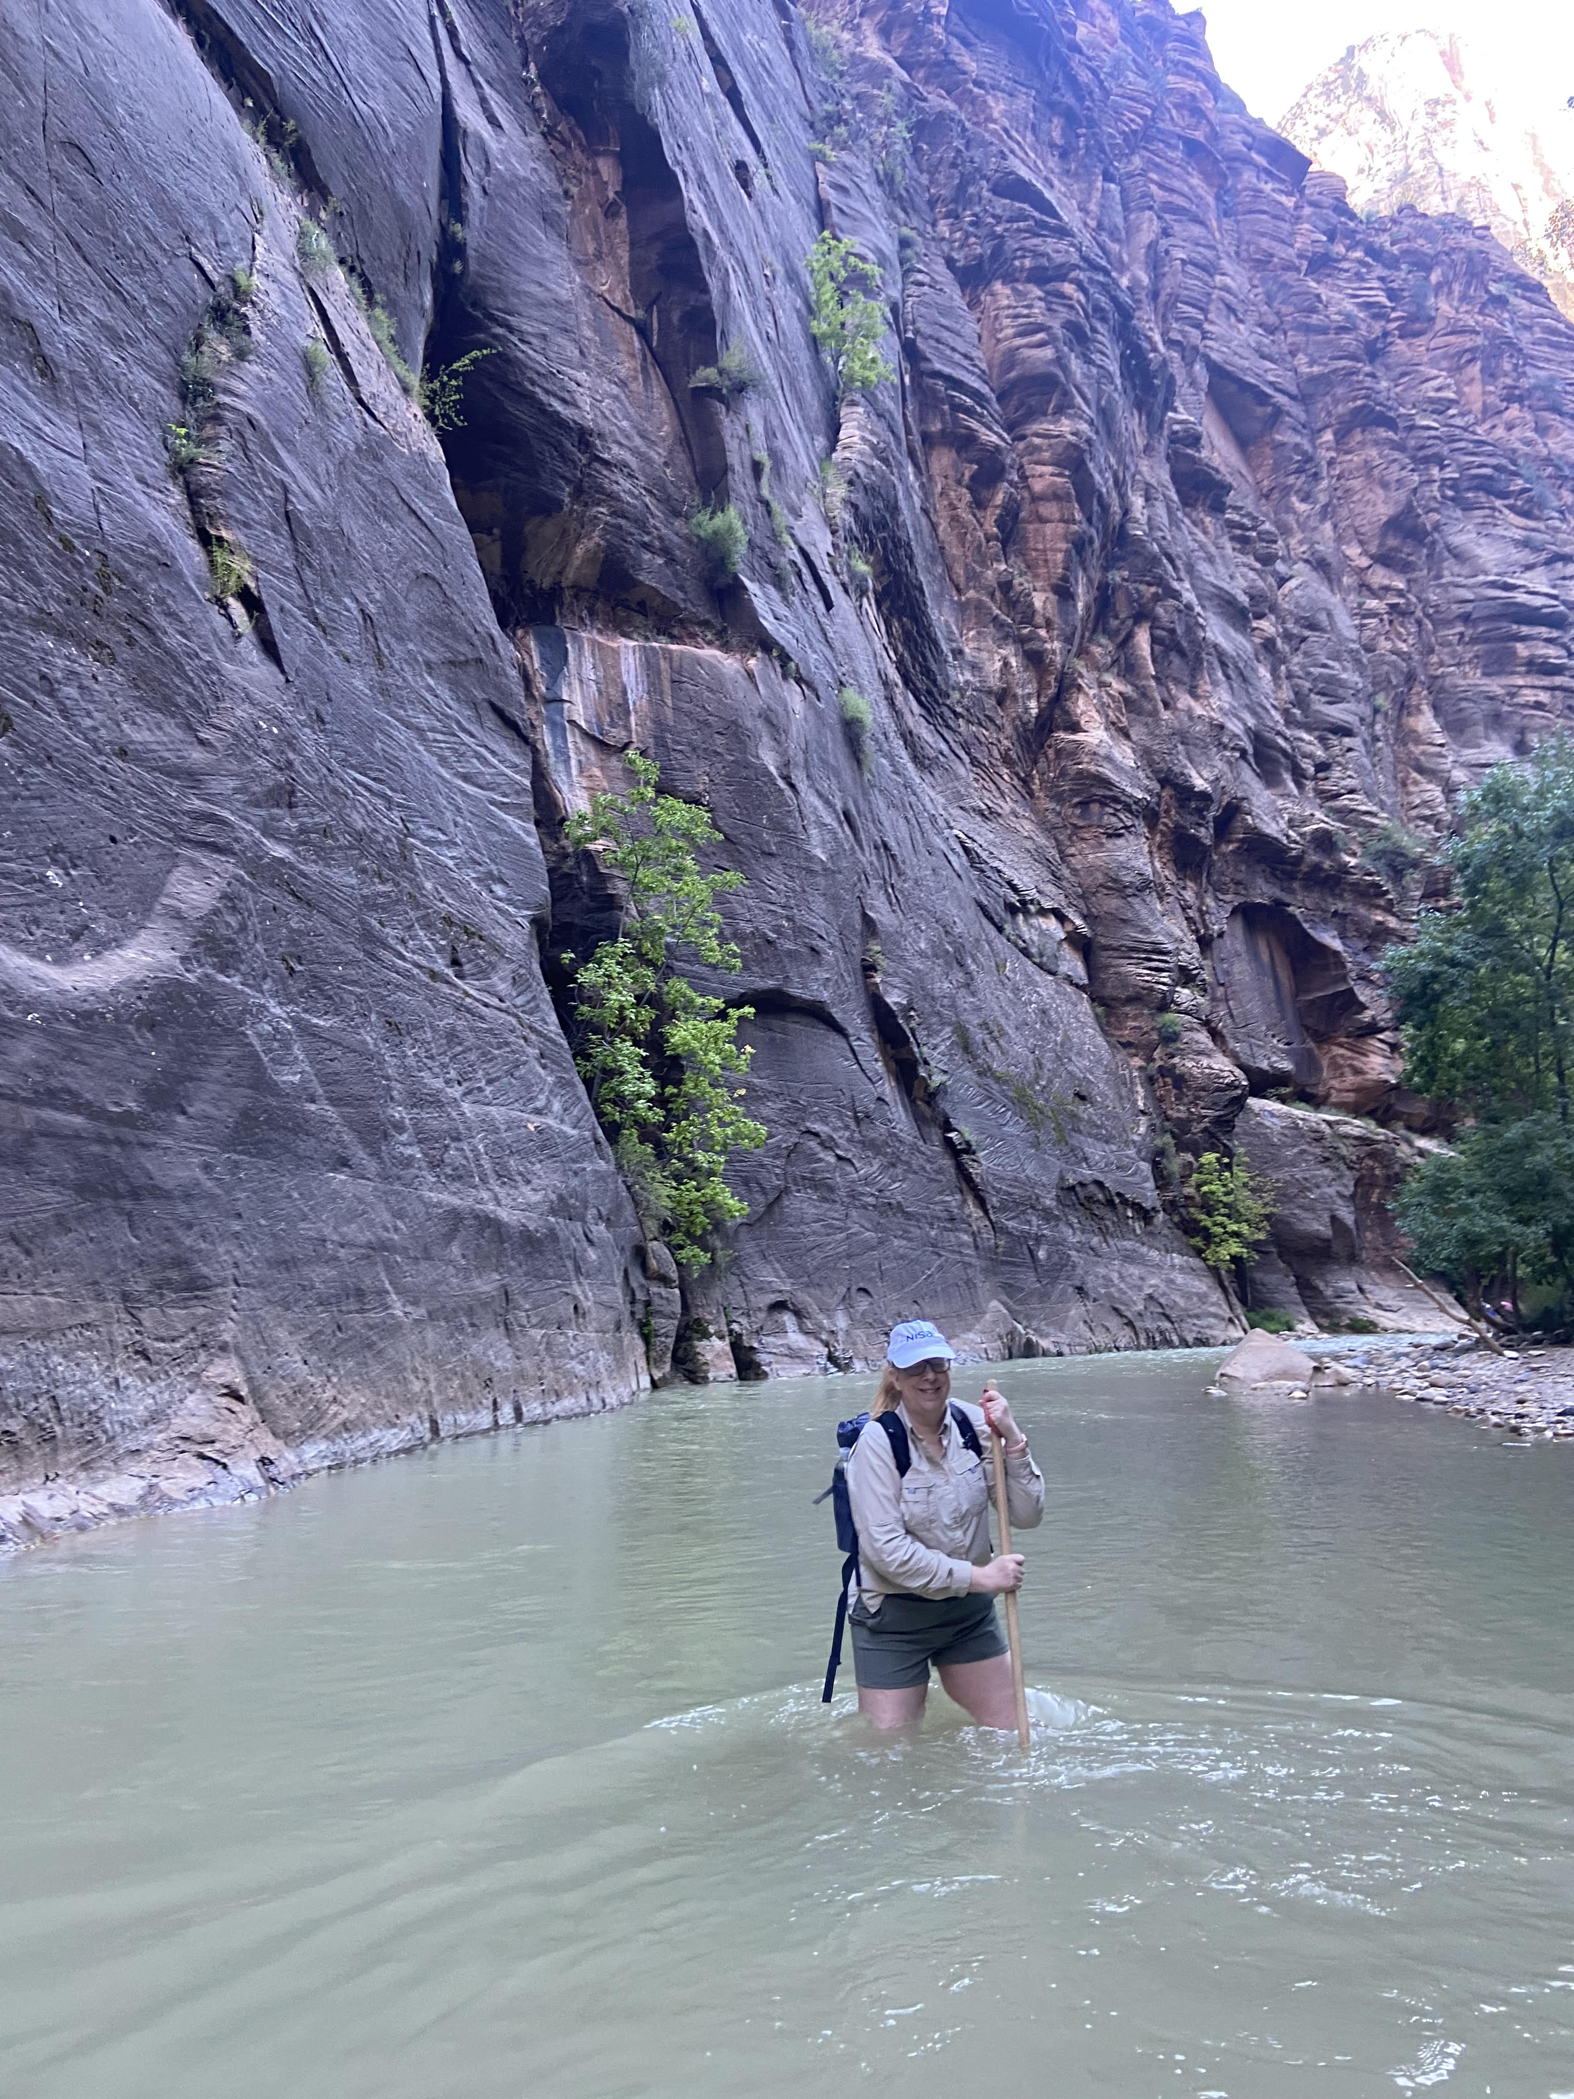
About Me
High school and then college writing instructor
Needed full-time job!
Went through LaunchCode SQL cohort
Hired at NISA!
Asked to come back and TA and then be a lead mentor
Passionate about database security
(Zion—Narrows)
Notes:
High school and then college writing instructor
Needed full-time job!
Saw Tweet re CoderGirl @ 2 a.m.
Went through LaunchCode
Hired at NISA!
Asked to come back and TA and then be a lead mentor
LaunchCode changed my life and now give back for others
St. Louis SQL Server and BI user group speaker and advisory board
Passionate about database security

Slide 3
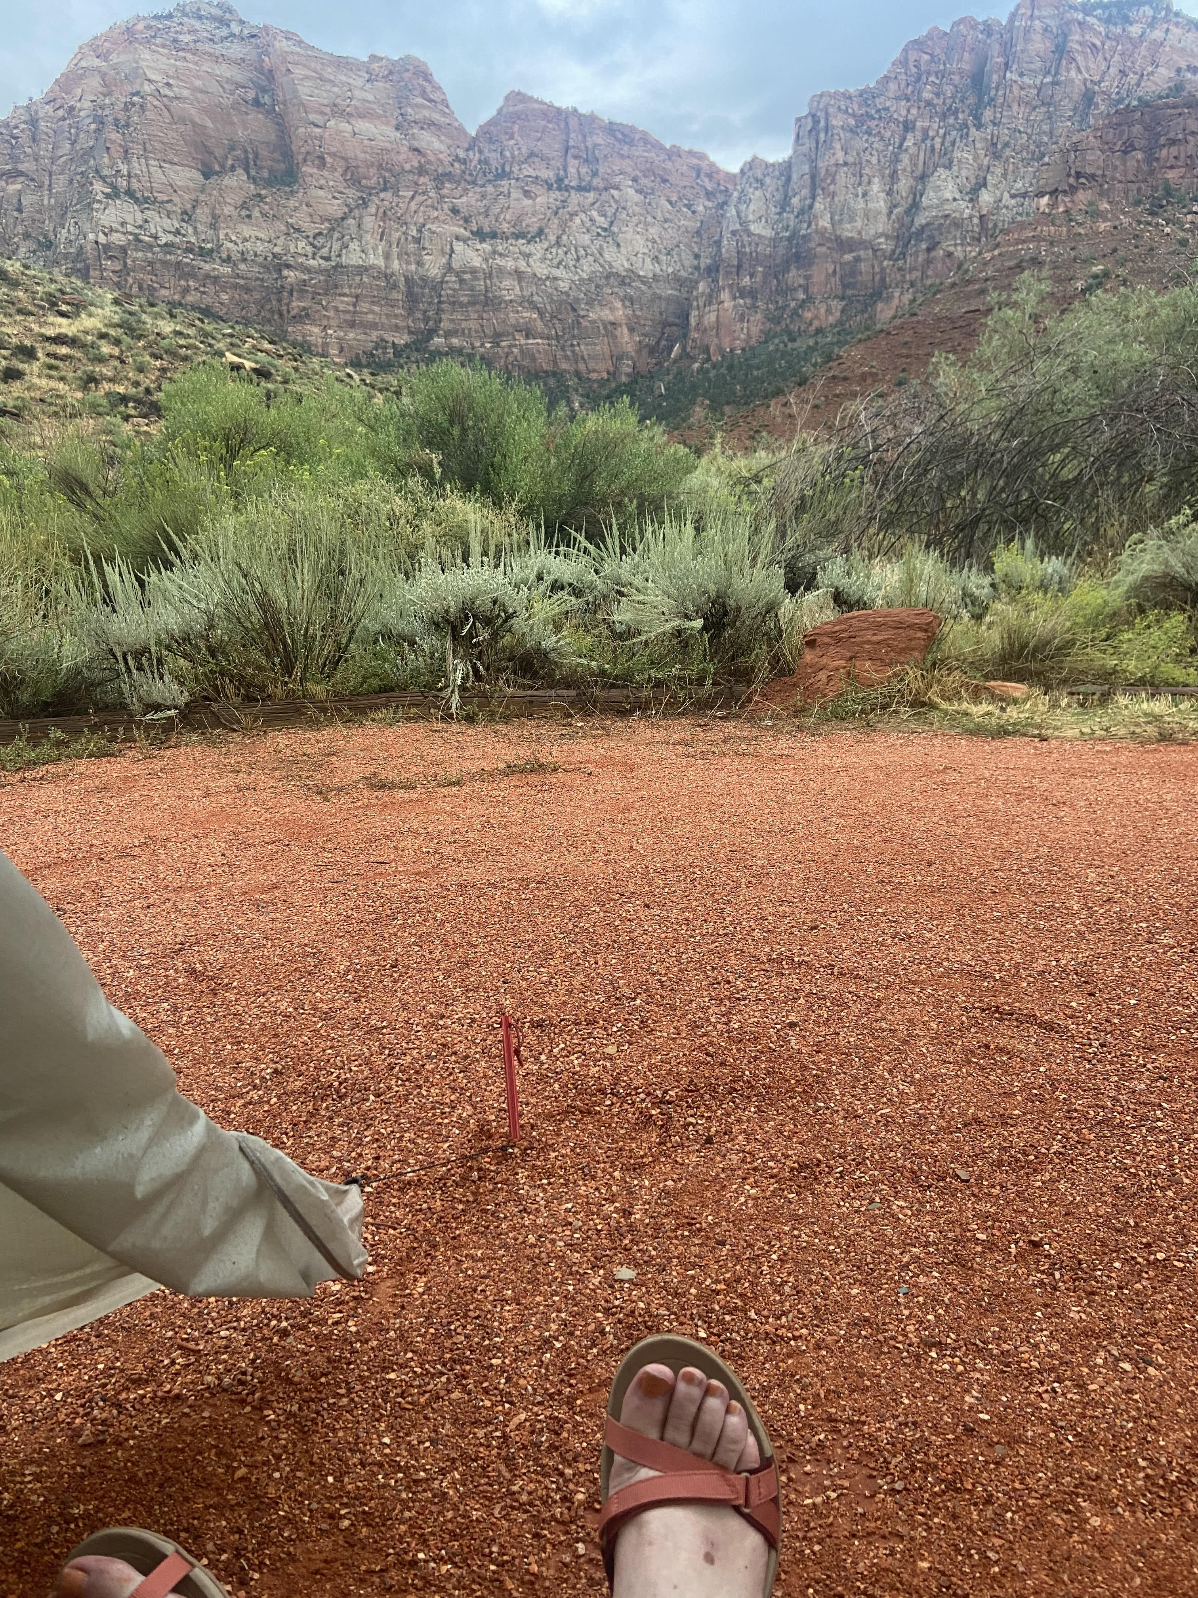
Expectations
Not introductory, not in the weeds—passion to help others on the journey to improve database security
Basic knowledge of how permissions work
Login vs user
Role
Securables
(Zion—view from my tent)
Notes:
Ask questions! Put in chat

Slide 4
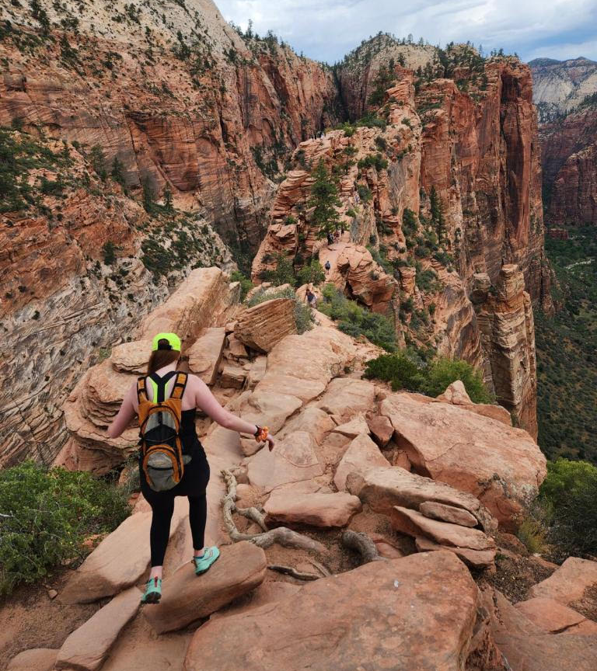
Principle of Least Privilege
Security principle to only provide access to what people need when they need it
Securables! Specific objects such as tables, views, stored procedures or schemas that we can grant or deny permissions on
Temporary! Don’t grant permanent permissions needed for troubleshooting an issue
Don’t grant permissions not needed to do the job!
(Angel’s Landing at Zion—my daughter Allison Harris)

Slide 5

Elevated permissions issues to solve
Not possible to grant without high level
Truncate table
Set identity_insert on
Not granular
Ability to pull from audit logs
Many dmvs require view server state
Cross-database
Dynamic SQL
Bryce Canyon

Slide 6
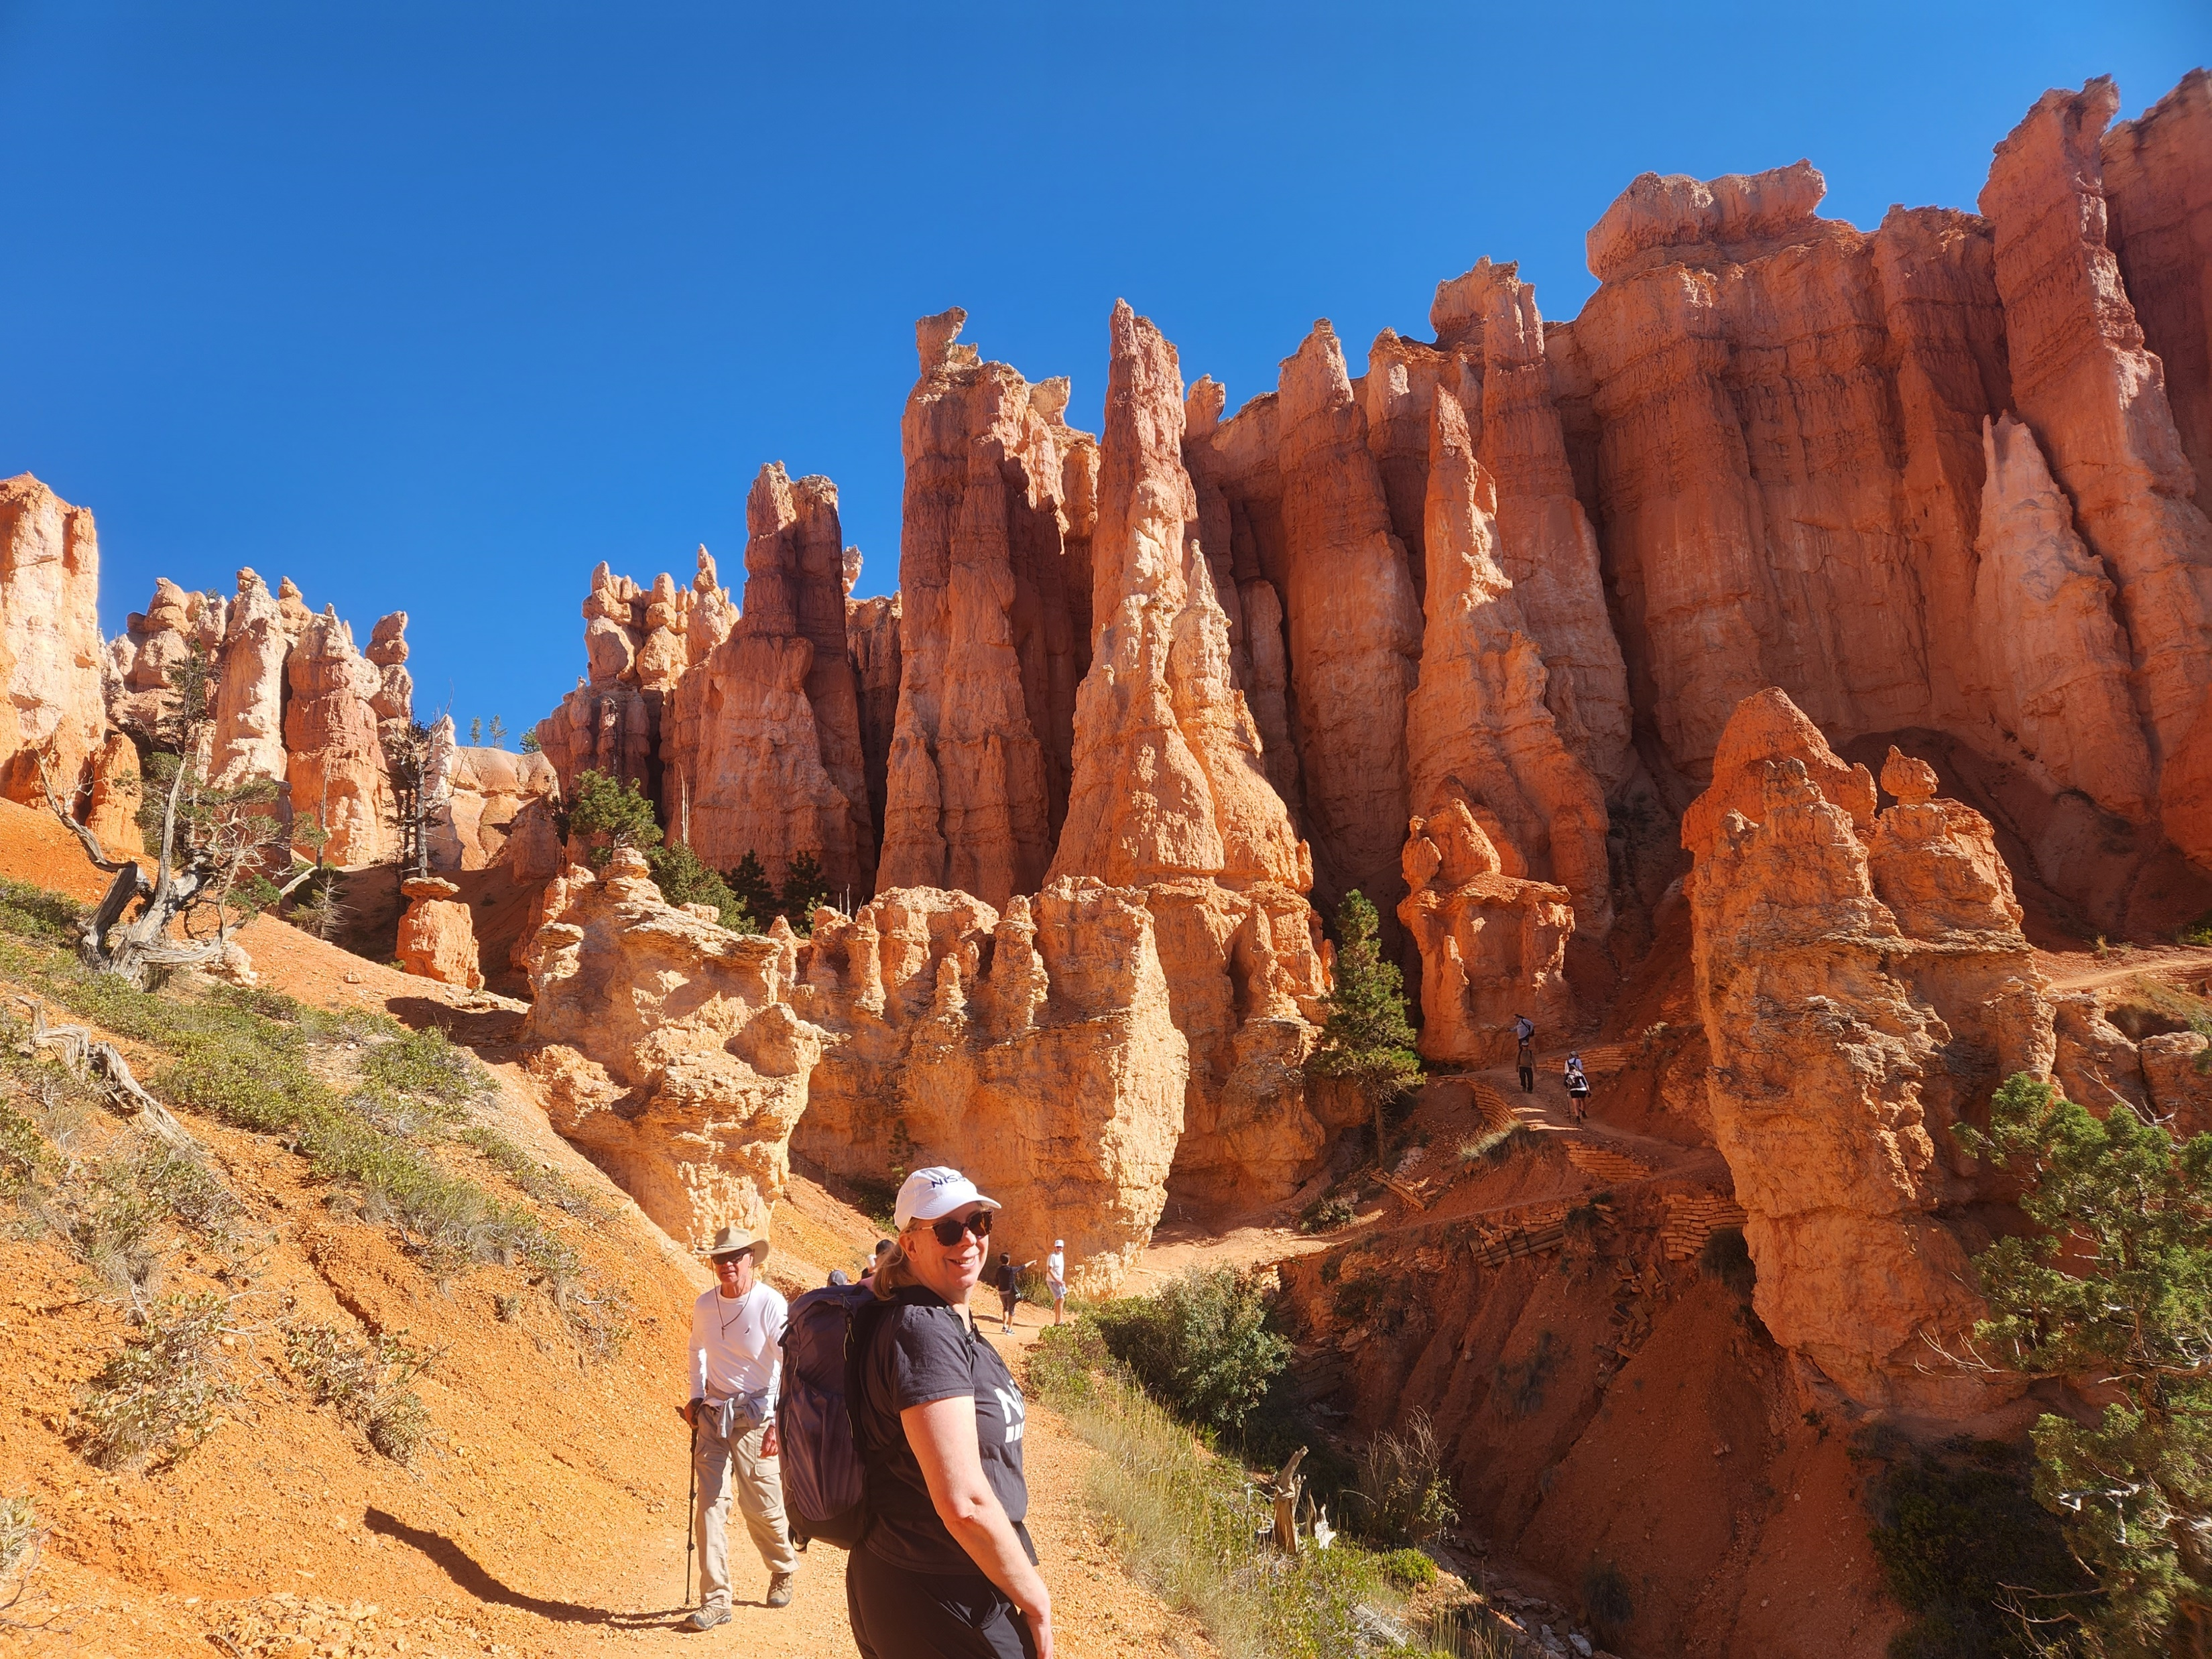
Three ways to avoid overly elevated permissions
Bryce Canyon

Slide 7
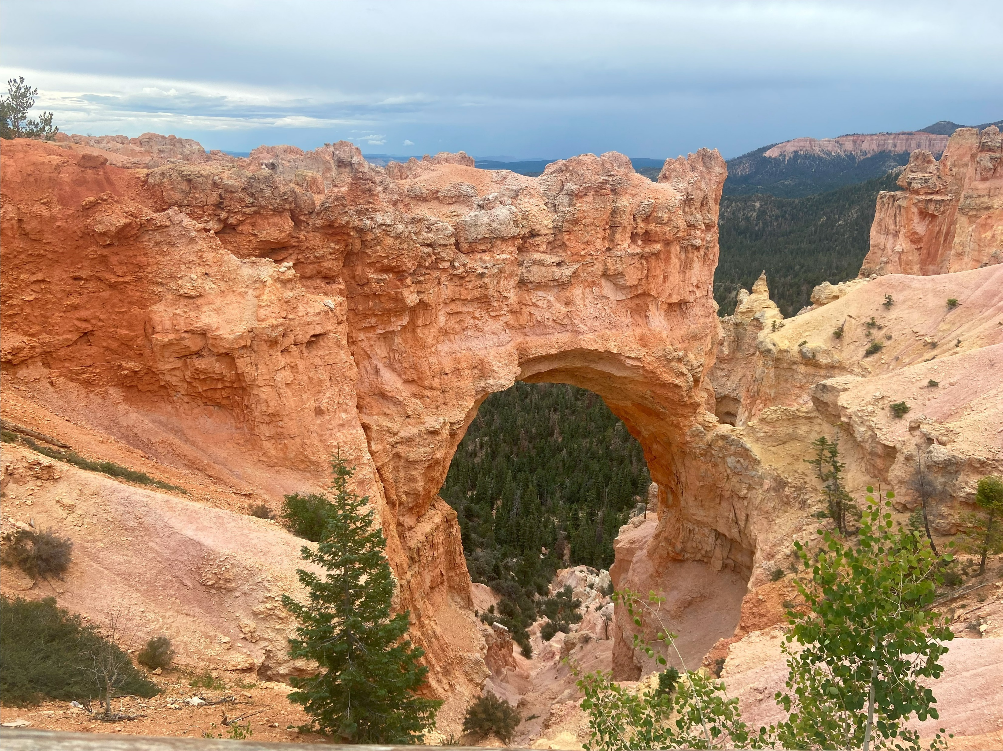
Ownership and cross-database ownership chaining
If you have execute on a sprod, those are extended to underlying objects as needed for the sproc to work
What breaks it?
Object ownership must be same
Only applies to select, insert, update, delete and execute
Dynamic sql
User doesn’t have connect (cross-db)
(Bryce Canyon)

Slide 8
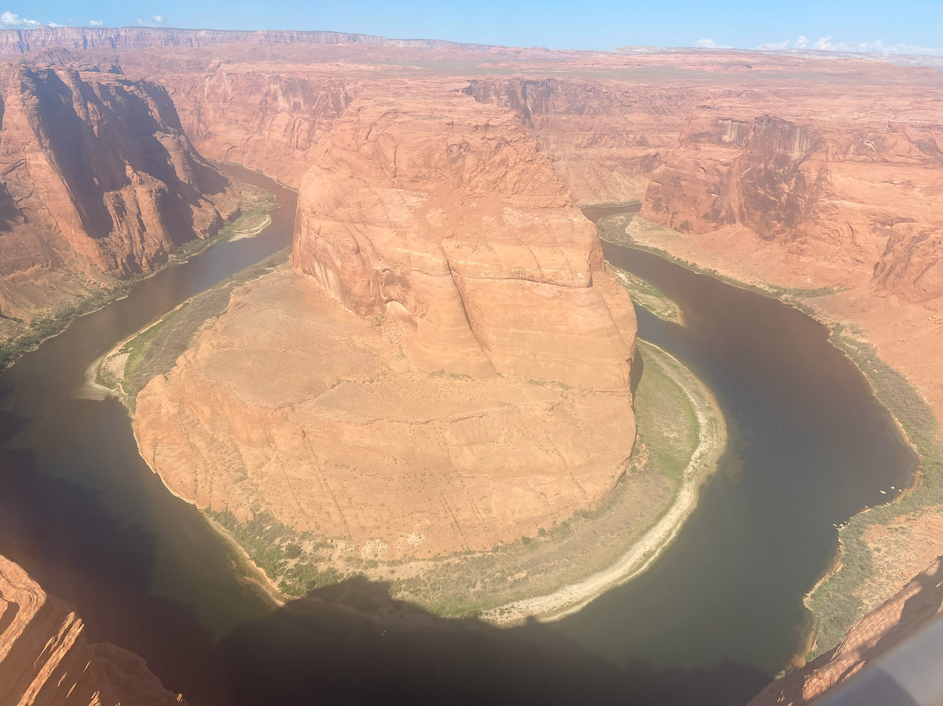
Execute As Owner
Impersonation
Security context changes
Demo!
(Horseshoe Bend)

Slide 9
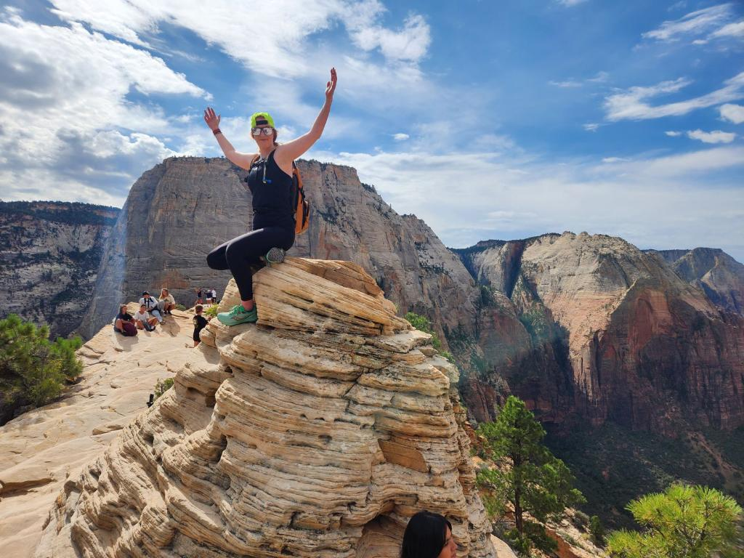
Module Signing
Ensures
Authenticity
change detection
Security context does NOT change
Can use multiple signatures in combination
Demo!!!
(Grand Canyon—my daughter Allison Harris)
Notes:
Process doesn’t get into Azure but was developed on-prem

Slide 10
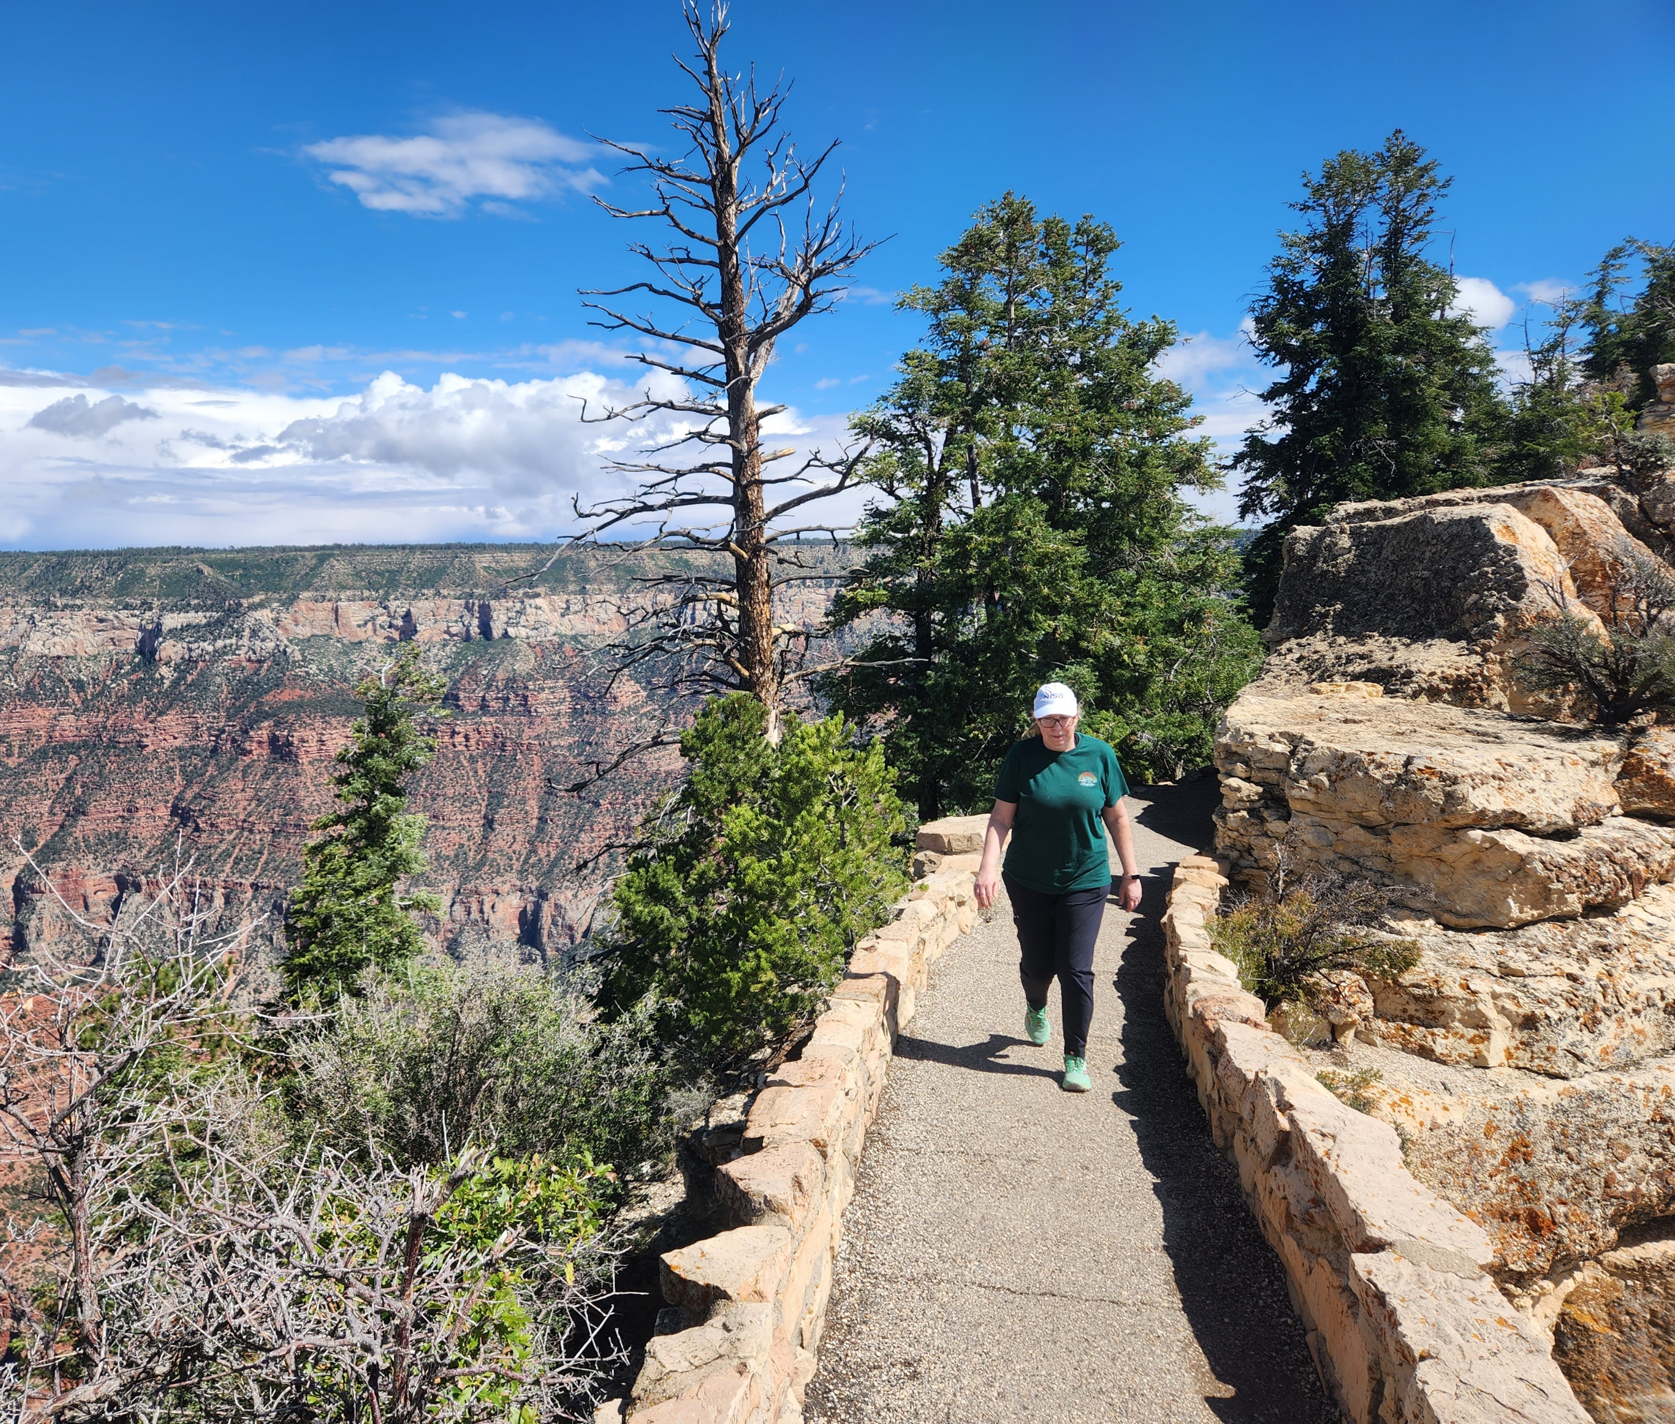
Contact info
sharon.reid.harris@gmail.com
https://github.com/InfoJunkie1/SignThoseSprocs
@Edudiva on Twitter
@edudiva@dataplatform.social on Mastodon
@edudiva.bsky.social on Bluesky
linkedin.com/in/Sharon-reid-44433654 on LinkedIn
(Grand Canyon—North Rim)

